Slide 1
FND B020 Accounting Lecture 01: Introduction to Accounting and Financial Statements
Notes:
Accounting is a flexible major. While many accounting graduates begin their careers in public or corporate accounting positions, accounting also provides valuable skills for many other career paths. Part of the role of an accountant is to understand the business well and be able to explain it to others
Experienced accountants can be business advisors and information specialists.
Some say Accounting is the Language of Business.
About this Course
Explain SIBT Learning (Moodle), unit guide, resources, quizzes, Glossary, online noticeboard, discussion forums, FAQs, contact information for lecturers and tutors
Explain the Student Workbook to be used in lectures and tutorials
Explain Socrative – you’ll need your phones in the lecture to answer some short questions so we can check how you are progressing
Homework requirements – textbook exercises

Slide 2

Learning Outcomes
2
What is Accounting
Who uses accounting information
Financial Accounting and Management Accounting
The Accounting Equation
Financial Statements
Notes:
Ask students to turn to their Workbook for the first exercise.
What is accounting – when would you use accounting in your daily life - why is it important – who is it important to? ( allow 5 mins to write their answers and encourage them to discuss and compare)
Randomly ask students to call out what they understand accounting to be.
Write some key words on whiteboard (system, standards, profitability, sales v expenses etc)
In Australia, many businesses fail after 3 years. Why? Stress the importance of good account keeping.

Slide 3

The Role of Accounting
3
Accounting is an information system
It measures business activity, processes data into reports and communicates results to decision makers.
Accounting is the language of business
The better you understand the language, the better you can manage your finances and make informed business decisions.
Notes:
SLIDE BUILD
Why do we need accounting?
Glossary – let students know about the Moodle Glossary – each week add to it with your words, accounting terms and a definition.

Slide 4
Who uses accounting information
4
Individuals. People like you who manage your personal bank accounts, decide whether to rent an apartment or buy a property, or budget your monthly income and expenses.
Investors and Creditors use accounting information to decide whether a potential customer is going to be able to pay them back.
Regulatory Bodies such as the Australian Taxation Office (ATO), State Governments, the Australian Stock Exchange (ASX).

Slide 5
Who uses accounting information
5
Internal users
Management: Senior, middle level & shop floor management, employees
Can you identify information that internal users may need to operate the business?
Was the Profit earned good or disappointing?
What products to sell or produce?
Rostering of staff and how many staff do we need?
Have we got enough cash to pay our short term debts?
Should we purchase a new item of equipment(asset)? Should we lease the asset?
Should we expand the business?
How can we reduce costs and be more efficient? And so on …….

Slide 6
Who uses accounting information
6
External users can include
Investors and Creditors use accounting information to decide whether a potential customer is going to be able to pay them back.
Regulatory Bodies such as the Australian Taxation Office (ATO), State Governments, the Australian Stock Exchange (ASX).
Potential investors
What type of information would these groups be interested in?
Should I invest my money in this business?
What are the future prospects of this business?
Has the business made a profit this year? And so on

Slide 7
Management Accounting and Financial Accounting
7
There are external and internal users of accounting information.
They use information for different purposes.
Financial accounting provides information to decision makers outside of the entity such as creditors, regulatory bodies, and the general public investor. General Purpose Financial Statements (GPFS) Balance sheet, Income statement
Management accounting is for internal decision makers. Special Purpose Financial Statements are reports for management for making strategic decisions - budgets, forecasts, sales projections. They help the business remain competitive.
Notes:
SLIDE BUILD x 3
Tell students we are only learning financial accounting. Management accounting is covered in the advanced diploma

Slide 8
International Financial Reporting Standards (IFRS)
In Australia, the Australian Accounting Standards Board (AASB) is a government appointed independent accounting body that is responsible for developing accounting standards. The AASB is gradually adopting the International Financial Reporting Standards (IFRS).
The IFRS are a set of guidelines that help preparers of financial statements decide how and what financial information is reported by businesses. The set of financial statements are called the General Purpose Financial Statements (GPFS).
This course focuses only on Financial Accounting and General Purpose Financial Statements (GPFS

Slide 9
Ethics and accounting
What is ethics?
Class discussion on the importance of acting ethically.
organisations needing to be aware of ethical behaviour:
be honest,
abide by the rules,
do the right thing.
A high standard of ethical behaviour is in the long term interest of business entities.
Students may have example of organisations acting unethically

Slide 10
Ch 2 Financial Statements
Types of business entities

Slide 11
Sole Proprietorship
Owned by one person.
The owner:
contributes “capital” to the business
entitled to receive all profits
profits are taxed as personal income.
owner is personally liable for all business debts (unlimited liability)
Examples: beauty salon, book store, dentist, optometrist, etc.
IMPORTANT TO NOTE:
Although there is no legal distinction between owner and the business, for accounting records, the owners’ personal transactions must be kept separate from the business.
11

Slide 12
Partnership
A business owned by two or more persons
usually 2 – 20 “partners”
Partnership Agreement
legal agreement between partners covering rights and responsibilities of partners, including capital contributions, salaries, and sharing profit
Partnership Act (1958) applies to all partnerships in Victoria
Partnership profit is distributed to partners as directed by Partnership Agreement
each partner’s share of profit is taxed as personal income.
12

Slide 13
Partnership continued
Like a sole proprietorship, for accounting purposes, the partners’ personal transactions must be kept separate from the business
partners are “jointly and severally liable” are for all business debts (unlimited liability)
all partners are personally liable for all debts of the business
Examples: solicitors, doctors, restaurant, etc.
13

Slide 14
Company
A business carried on by a separate legal entity
an “artificial person”
established by a “constitution” and “incorporated”
Controlled by directors
Corporations Act (2001) applies to all companies in Australia
all companies in Australia
must be registered and are regulated by ASIC (Australian Securities and Investments Commission)
14

Slide 15
Company continued
Company owners are “shareholders”
Business is carried on in the company’s name
the company is responsible for all it’s debts
shareholders are not personally liable for the company’s debts (limited liability)
Company profit is
subject to “company tax”
distributed to shareholders as dividends (after tax has been deducted)
Examples: BHP Billiton, Macquarie Bank, Wesfarmers, etc.
15

Slide 16
Introduce the 5 Accounting Elements with simple definitions
Assets - items of value owned (controlled) by the business
Liabilities - debts, amounts owing to outside organisations
Owners Equity - investment by owner(s)
Income - money earned in the normal operations of the business
Expenses - costs incurred in the normal operations of the business

Slide 17


17
Meet Adele…
Adele loves flowers and gardening. She wants to set up her own garden design business.
What will Adele need to set up her new business?
Notes:
SLIDE BUILD x 2
This is Adele – she wants to set up her own business – a garden design business. We are going to be following Adele and her business and all the other businesses she uses throughout this course.
First
Click – what will Adele need to set up her business?
Whiteboard
Step 1: Ask students to call out all the things Adel will need to set up her business.
Write the responses on the whiteboard in 3 columns – categorised by you secretly as Assets Liabilities and Equity
Possible answers: find premises (rent), buy equipment (paper, computer, stationery, measuring tape, design software), car, insurance on the car, get a loan, use her own money, Prompt for other costs.
Step 2: Above each column, write Assets, Liabilities and Equity (just the terms at this stage)
Step 3: Ask students what is meant by these terms. This is the language of accounting.
Explain that assets are Benefits - they do good for the business
Explain that liabilities are debts – the business owes someone something - where did Adele get the money to buy the assets – did she borrow it, take a loan or, or bought on credit ( 30 days to pay the supplier) NOTE: buying things with a credit card is the same as cash. For accounting purposes.
Explain that Equity refers to the owner’s financial interest in the business – what they have put in and what they can take out.
For example, Adele could also have used some of her own cash to set her business up.
Step 4: write in the equals and plus sign to make the equation. Explain this is the accounting equation and everything is based on this. It must always balance.
So let’s check we all understand the definitions of these terms – assets and liabilities
Step 5: show next slide with formal definitions for Assets and Liabilities then
Step 6: go back to whiteboard to look at Equity in more detail
The items listed should be rent, advertising, brochures, business cards, insurance, her own savings
Tell students you are going to categorise these items into capital, drawings, income, expenses – write this next to each item.
Step 7: The Accounting Equation

Slide 18
Assets
18
Assets are resources controlled by the business as a result of past events. They provide future economic benefit.
Typical assets:
Cash at bank,
Accounts Receivable (debtors)
Inventory,
Equipment,
Vehicle,
Notes:
BUILD SLIDE
Make sure students understand the term “resources” – things that can be used in a business to do business (people are resources)
Add this definition to student workbook
Liabilities are present obligations of an entity arising from past events, the settlement of which is expected to result in an outflow from the entity of resources embodying economic benefits”
[International Financial Reporting Standards – Conceptual
Framework]

Slide 19
Liabilities
19
Liabilities are present obligations of a business arising from past events which will settled by a outflow of resources (assets) to another entity. Liabilities are ‘outsider claims’.
Typical Liabilities (debts):
Bank loan is the most common form of long term borrowing for a business. A bank loan provides medium or long-term finance. The bank sets the fixed period over which the loan is provided (e.g. 3, 5 or 10 years), the rate of interest and the timing and amount of repayments. A bank loan is classified as a non-current liability as the debt will take more than a year to repay.
Accounts payable is an essential tool for financing business growth. Accounts payable is extended to a business by suppliers who let you buy now but pay later.. It is classified as a current liability that you will be expected to repay in full (fully settled) within 1 year.
Notes:
BUILD SLIDE
Make sure students understand the term “resources” – things that can be used in a business to do business (people are resources)
Add this definition to student workbook
Liabilities are present obligations of an entity arising from past events, the settlement of which is expected to result in an outflow from the entity of resources embodying economic benefits”
[International Financial Reporting Standards – Conceptual
Framework]

Slide 20
Liabilities are obligations (amounts owing) of a business to transfer assets or provide services to another entity. Liabilities are ‘outsider claims’.
Typical Liabilities (debts):
Other payables These are purchases on credit that do not involve direct costs to items that form part of the goods or services of your business. They are purchases needed to help support the main operating activities of your business.
Notes:
BUILD SLIDE
Make sure students understand the term “resources” – things that can be used in a business to do business (people are resources)
Add this definition to student workbook
Liabilities are present obligations of an entity arising from past events, the settlement of which is expected to result in an outflow from the entity of resources embodying economic benefits”
[International Financial Reporting Standards – Conceptual
Framework]

Slide 21
Equity
Equity represents the business owner’s wealth or interest in the business. Equity also reflects the rights of owners on the business assets.
Equity (Capital or Owner’s Equity)
When starting a business, the owners can contribute funds into the business to finance various asset purchases to be used in the business operations. Adele can choose to contribute at any time during the life of the business. Her first (initial) contribution is usually known as seed money.
Important concept: Owner’s contribution is treated as equity and is completely separate from any business profits Adele hopes to make after the business starts (commences) operating.
Notes:
BUILD SLIDE
Make sure students understand the term “resources” – things that can be used in a business to do business (people are resources)
Add this definition to student workbook
Liabilities are present obligations of an entity arising from past events, the settlement of which is expected to result in an outflow from the entity of resources embodying economic benefits”
[International Financial Reporting Standards – Conceptual
Framework]

Slide 22
The Accounting Equation It must always balance
22
ASSETS
-
=
LIABILITIES
+
+
EQUITY
Assets - Liabilities = Net Assets (Equity)
Or
Assets = Liabilities + Equity
Notes:
SLIDE BUILD
The accounting equation is a key principle of accounting. It must always balance.
Click
It is just a maths equation
SAY: Assets less liabilities = net assets = equity
Ask students what is the purpose of having assets in a business?? Answer =They must make a profit
And that profit is used to …pay loans, expenses

Slide 23
Activities 10 and 11 in workbook

Slide 24
The Accounting Equation Equity is made up of 4 activities
24
ASSETS
=
LIABILITIES
EQUITY
+
Capital
improves equity
Drawings
reduce equity
Income
improves equity
Expenses
reduce equity
Notes:
BUILD SLIDE
ASK: what do we mean by equity in a business?
Equity consists of 4 accounts.
Let’s look at what each of these is.
Capital -
Drawings
Income (or revenue)
Expense
Provide a meaning for each.
Give examples of each and ask students for other examples of each too.
drawings – taking any asset out of the business for private use
Explain DRAWS = take out
Ask what happens if Adele keeps taking money out of the business.
Explain that Drawings can be any asset eg a computer she decides to keep at home
Question: If the business owner puts money into the business, is this income?
Ask students for a show of Hands - up yes, hands up No
ASK: how does each of these affect the Equity in a business?
CLICK: to reveal how each one affects equity
Explain the Income – Expenses = profit/loss

Slide 25
Linking the Financial Statements
25
ASSETS
=
LIABILITIES
EQUITY
Balance Sheet
+
Capital
Change in Equity Statement
Drawings
Income
Income Statement
Expenses
Notes:
BUILD SLIDE
We will be learning how to prepare 3 financial statements.
Let’s see where the information for these statements come from.
1 Balance Sheet
2. Income Statement
3. Change in Equity Statement
The four equity accounts together go to the Change in Equity Statements

Slide 26
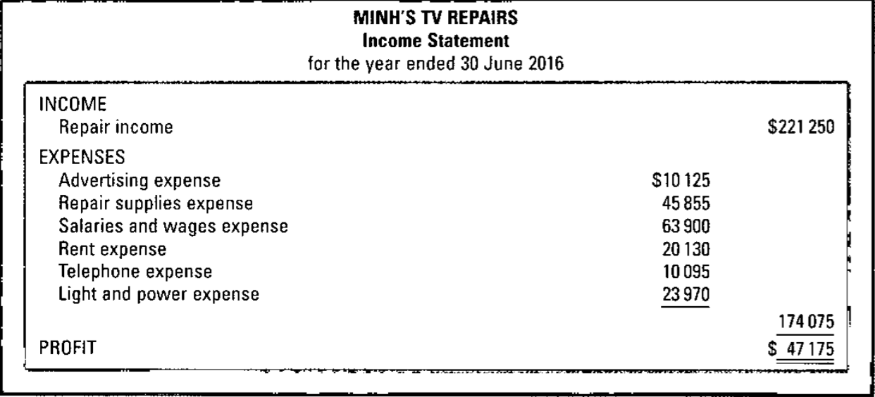
26
The Financial Statement
Income Statement
Notes:
Sample Income Statement
What is the purpose of these accounts? – what do they tell us?
Who is interested in this information? Elicit business owner, staff, other companies, investors, banks – for a loan approval, governments,Tax Office
Income / Revenue: what the business earns, represents an increase in the wealth of the owners.
Examples: sales revenue
service revenue
Expenses: costs incurred by the business to earn income,
ASK students: What do expenses do to the wealth of the business owner? Decrease wealth.
ASK students by show of hands: If Income is more than all the business Expenses, the business has made a profit or loss?

Slide 27
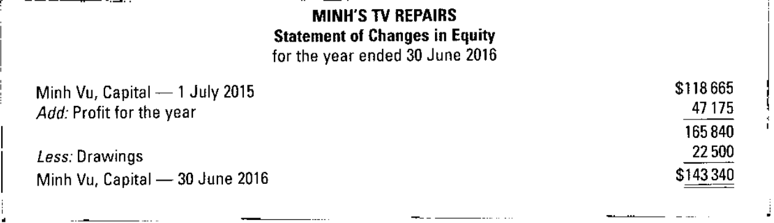
Financial Statement
Statement in Change in Equity
27
Notes:
Statement of Changes in Equity explains the change in the balance of equity during the period ie it shows how the business owner’s wealth has changed

Slide 28
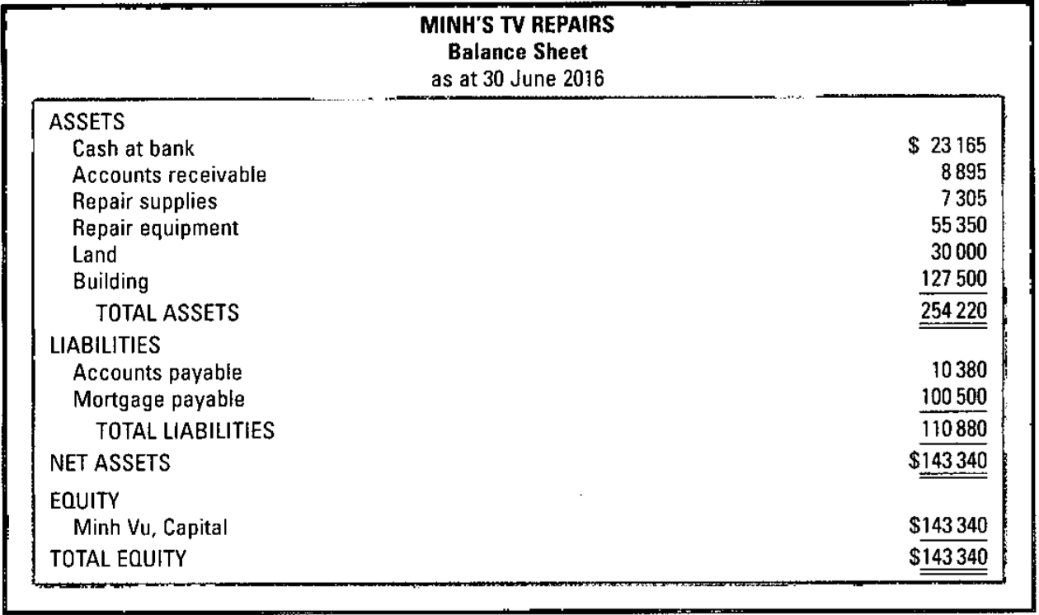
The Financial Statement
Balance Sheet
28
Notes:
Sample Balance Sheet
This is one kind of the standard information that is prepared for a company.
By the end of this unit you will have an understanding of this document and how to prepare one for a simple business. You’ll also gain an understanding of how to read these statements and describe what it is telling you about a business.
There are key terms on this - you’ll need to understand these terms – the language of accounting.
The Balance Sheet shows:
• the assets in which the entity has invested
• how the entity has financed the assets
Notice that Total Assets = Total Liabilities and Equity
All Balance Sheets have the same terms and are displayed in the same order – no matter what the company.

Slide 29
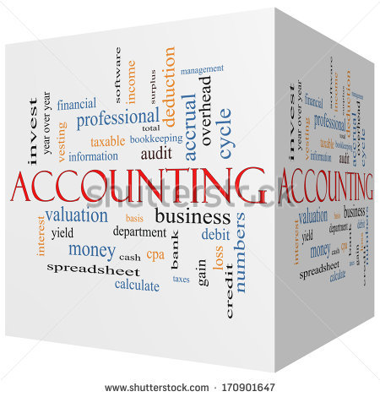
Classifying types of transactions
29
Transactions and events relating to a business need to be classified into elements in a financial statement:
Income and Expenses into the Income Statement;
Assets, Liabilities and Equity into the Balance Sheet;
Income Statement reports on the operations or financial performance.
Balance Sheet reports the financial position or the sources of funds and how these funds are used. A = L + OE
Refer to Task 14 in your workbook
Notes:
White Board: Assign each item for setting up the business an Account name.
Equipment, vehicle, loan, capital
Then introduce accounts payable and receivable.
Give rent as an example - if she pays in advance it is a prepayment which is an ASSET account name would be prepaid rent
Is she going to pay for her office equipment up front , in advance – she might be able to pay for it “on account” which means account payable
An annual insurance policy is prepaid so it goes into asset, called prepaid insurance.
Go to Workbook - time to digest acctg equation, classify account names into assets or liabilities refer to text for examples, add some words to the glossary
Now some practice with the accounting names and categorising assets, liabilities etc
practice with Acctg Equation

Slide 30
Accounting Entity assumption
the transactions of an entity are recorded, classified and summarised into financial statements,
Under the accounting entity assumption, the entity is considered a separate entity distinguishable from its owner
It is assumed that each entity controls its assets and incurs its liabilities. The records of assets, liabilities and business activities of the entity are kept completely separate from those of the owner of the entity.
The accounting entity assumption is important since it leads to the derivation of the accounting equation: Assets = Liabilities + Equity

Slide 31
Accrual Assumptions
The effects of transactions are recognised in accounting records when they occur, and not when the cash is received or paid.
Hence, financial statements report not only on cash transactions but also on obligations to pay cash in the future and on resources that represent receivables of cash in future.
accounting on an accrual basis provides more accurate information for the purpose of decision making by users of financial statements than does the cash basis.

Slide 32
Going concern assumption
The entity is expected to continue operating into the future. It is assumed that the assets of the entity will not be sold off and that the entity will continue its activities;
The significance of the going concern assumption is in the valuation placed on the assets of an entity in the entity’s financial statements. The value would be the original or historical cost of the asset not the value of the assets if the entity was being closed down (liquidated)

Slide 33
Accounting period assumption
For financial reporting purposes, it is assumed that the total life of an entity can be divided into equal time intervals (eg year, or month). Hence, the financial performance of the entity can be determined for the period, and the financial position of the entity can be determined on the last day of that reporting period.
As a result of this assumption, profit determination involves a process of recognising the income for the year and deducting the expenses incurred for that same year.
Together, the period assumption and accrual basis assumption lead to the requirement for making end-of-period adjustments on the last day of the reporting period.

Slide 34
Task 17 Accounting assumptions
Work with the teacher and attempt the questions in your workbook
17 Understanding the accounting assumptions

Slide 35
Tutorial Homework tasks
From text book
Exercise 2.9, 2.12
Problem 2.2, 2.3
Glossary
Kahoot task Week 1

